Slide 1
Experimental and Real-World Analysis of the Relationship Between Wind Speed and Atmospheric Pollution Concentration
By: Dylan Epstein-Gross, Krishna Patel, Leonard Volchek, Anna Liu, and Prabhas Kurapati
FSU Young Scholars Online Program 2021
Notes:
Experimental and Real-World Analysis of the Relationship Between Wind Speed and Atmospheric Pollution Concentration

Slide 2
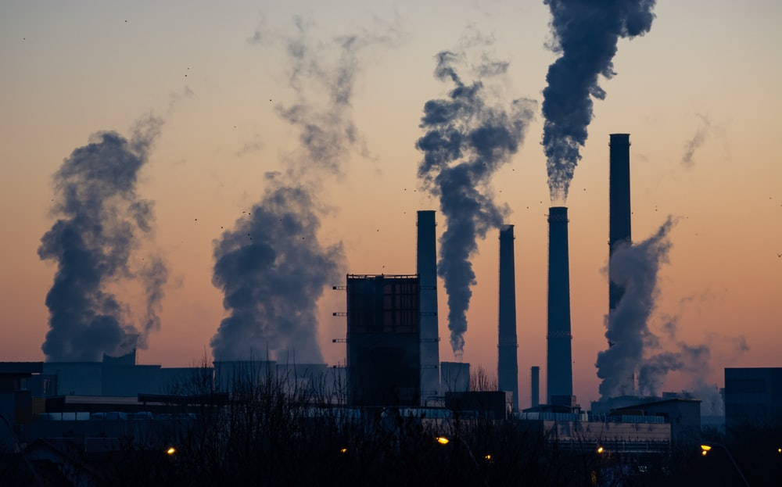
Background
Investigation into relationship between wind speed and air pollution concentration
Wind inversely affects pollution concentration
Multiple analyses - water flume and city AQI data

Slide 3
Research Question
How is ground-level atmospheric pollution concentration affected by wind speed?
Hypothesis
With higher wind speeds, the pollution concentration will be lower, and with lower wind speeds, the pollution concentration will be higher.

Slide 4
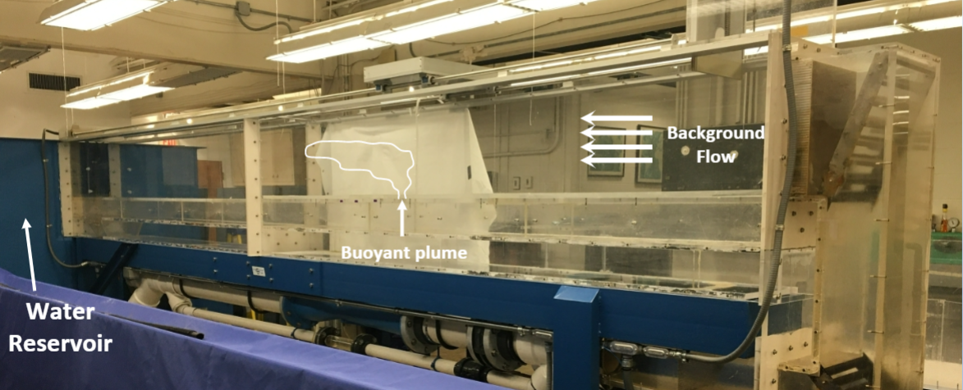
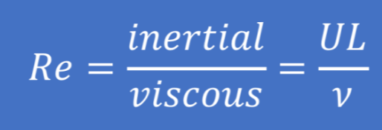
Methodology Pt. 1
Experimental Flume Data
“A carefully designed tank can be a good scale model of real topography and realistic atmospheric conditions” (Reuten et al. 2007)
Highly repeatable
Permits difficult measurements
Buoyant plume resembles pollutant in wind
Laminar background flow
Reynolds number similarity to real world
Notes:
To start off with testing this hypothesis, we decided to use data from a real, physical experiment run by the FSU Geophysical Fluid Dynamics Institute. While most studies of air pollution patterns rely on data from computer simulations or large-scale observations, a water tank experiment like this one can have important advantages - as Reuten et al. puts it, “A carefully designed tank can be a good scale model of real topography and realistic atmospheric conditions” that is highly repeatable and permits measurements which would be difficult or even impossible by other means. The picture on the right showcases the experimental setup: water is pushed through a large horizontal plume in a laminar background flow, and a buoyant plume of dyed liquid is released from the floor of the flume to simulate pollutant emission from something like a smokestack. By varying the flow rate, we can simulate changes in wind speed and see how the “pollutant” is affected. We also know due to Reynolds number similarity that this is an appropriate model for real-world air pollution despite the obvious differences in scale and viscosity.

Slide 5
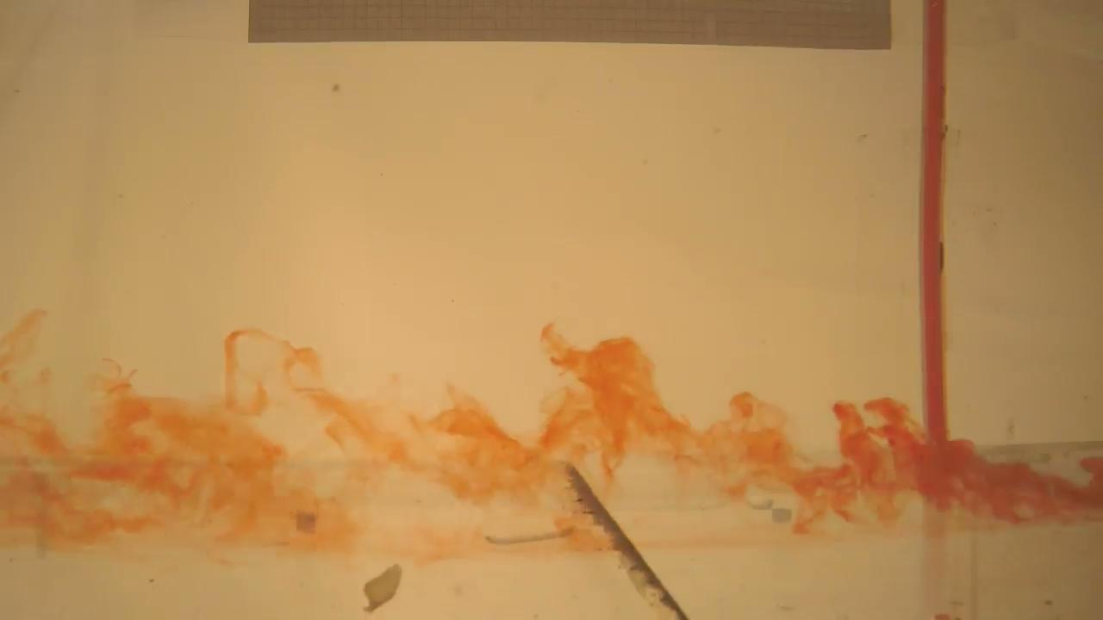

Methodology Pt. 1
Flume Videos
Plume recorded with nearby camera
2 videos without obstacles: 0.04 m/s, 0.15 m/s
2 videos with single building obstacle: 0.04 m/s, 0.15 m/s
Figure 1: 0.15 mps - No Obst
Figure 2: 0.15 mps - 1 Building
Notes:
With a stationed camera we obtained 4 key videos of the flume experiment. In two of the videos, the plume flows along a completely flat plane, while in the other two a plastic rectangular prism is fixed in place to simulate the interference of a building. The combination of these two sets of videos allows us to get an idea of how air pollution interacts with both rural and urban environments. Each of the two sets also has one video with low flow rate (0.04 m/s) and one with high flow rate (0.15 m/s). Here you can see two videos with the same high flow rate, with Figure 1 having no obstructions... and Figure 2 having an obstruction.

Slide 6
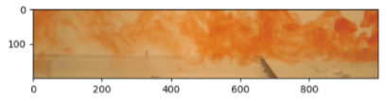
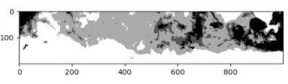
Methodology Pt. 1
Flume Video Analysis
Cropped Frame
Each video cropped to “ground-level” and 20 frames extracted from middle
Heuristic method used to determine “red” pixels - R - G > 60 and R - B > 60
Pixel categorization: Use heuristic thresholds
“Light”: R + G + B > 370
“Medium”: 370 > R + G + B > 350
“Dark”: 350 > R + G + B
Converted to Light/Medium/Dark
Notes:
To get usable quantitative data from these videos, we took 20 representative frames from the middle and cropped them to encompass only the “ground-level” portion of pollutants. We scanned through the pixels and used a heuristic measure to separate the reddish pixels from the rest. Then we used a brightness heuristic and experimented with a few different thresholds to split the red pixels into light, medium, and dark portions - dark means highest concentration, light means lowest concentration. The thresholds and cropping window were kept the same for all videos. On the right you can see what a frame looks like after it has been cropped and converted to this light/medium/dark scheme.

Slide 7
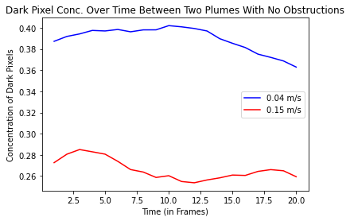
Results Pt. 1
(No Obstructions)
Table 1
Figure 3
Brightness Flow Rates (m/s) Conc. Avgs P-Value
Dark | 0.04 0.15 | 0.389 0.266 | p < 0.01
Medium | 0.04 0.15 | 0.111 0.077 | p < 0.01
Light | 0.04 0.15 | 0.101 0.111 | p < 0.01

Slide 8
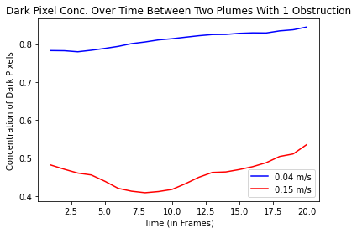
Results Pt. 1
(1 Obstruction)
Table 2
Figure 4
Brightness Flow Rates (m/s) Conc. Avgs P-Value
Dark | 0.04 0.15 | 0.812 0.458 | p < 0.01
Medium | 0.04 0.15 | 0.087 0.042 | p < 0.01
Light | 0.04 0.15 | 0.075 0.050 | p < 0.01

Slide 9
Evaluation of Flume Data
Significant difference in concentration across the two flow rates - for the most part higher flow rate indeed correlates to lower dark conc. and higher light conc.
Findings support literature that claims an inverse relationship between wind speed and pollutant concentration
Limitations/Errors in Findings
Heuristic methods used to find pixel concentrations of different saturations
Flume is very idealistic - representative of real-world trends?
Notes:
Dang can’t think of any good pictures here either… I guess it’s fine without them lol ok

Slide 10
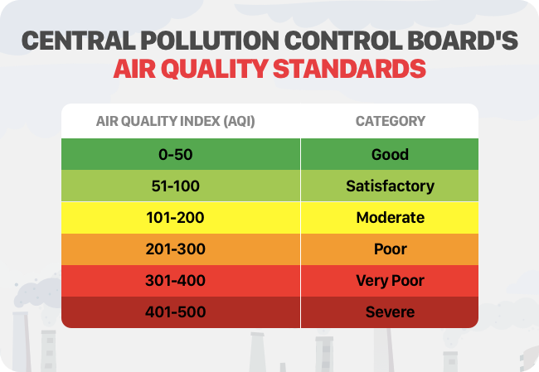
Methodology Pt. 2
National Wind-Speed/AQI Data
Looked at the air quality index (AQI) and wind speed data for three pairs of cities in 2019 across USA.
Wind speed data from Weather Underground
AQI data from U.S. Environmental Protection Agency
AQI takes concentration of 4 major pollutants into account - ozone, particulate matter, CO, SO2
Higher AQI → higher air pollution concentration
Notes:
Cut down info and maybe add stuff on slide to script (no complete sentences on slide!) No need to be so specific about Weather Underground or EPA

Slide 11
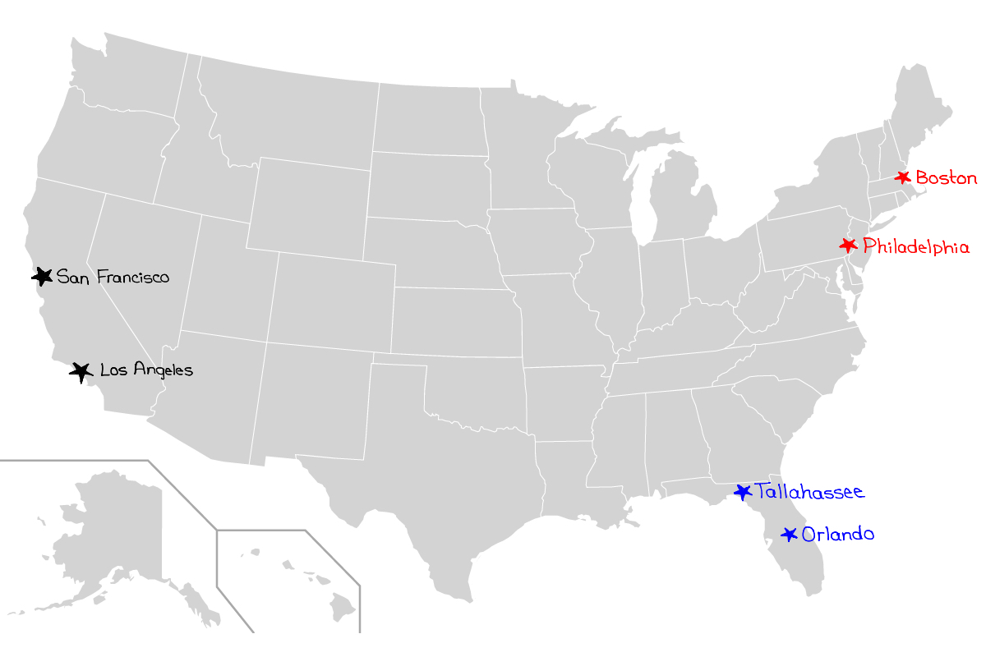
Methodology Pt. 2
Data Analysis Procedures
3 pairs of U.S. cities chosen:
San Francisco and Los Angeles
Boston and Philadelphia
Tallahassee and Orlando
Pair similarities - climate, region, urbanization
But chosen to maximize difference in wind speed
Data collected from every day of 2019
Ran t-Tests between the wind speed and AQI data for each pair with Python

Slide 12
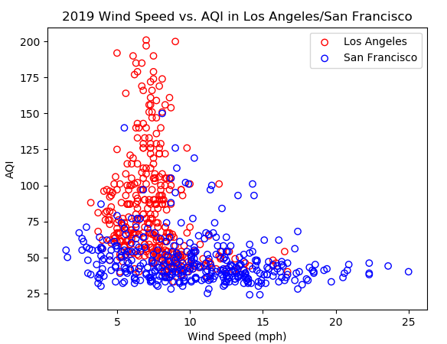
Results Pt. 2
Los Angeles and San Francisco
Table 3
Figure 5
 | Los Angeles | San Francisco | P-values
Mean Wind Speed (mph) | 7.58 | 10.4 | p < 0.01
Mean AQI | 82.6 | 47.8 | p < 0.01

Slide 13
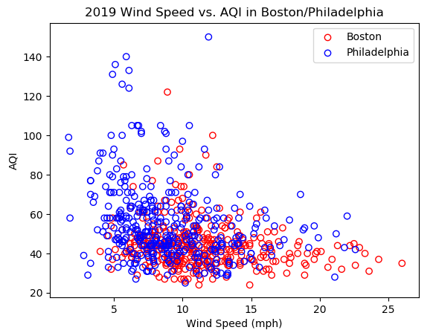
Results Pt. 2
Boston and Philadelphia
Table 4
Figure 6
 | Boston | Philadelphia | P-values
Mean Wind Speed (mph) | 11.3 | 8.99 | p < 0.01
Mean AQI | 44.2 | 55.6 | p < 0.01

Slide 14
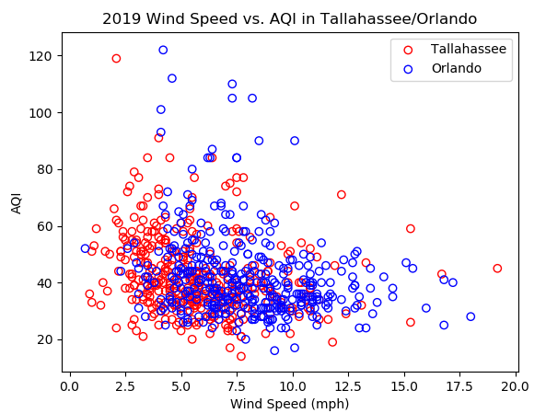
Results Pt. 2
Tallahassee and Orlando
Table 5
Figure 7
 | Tallahassee | Orlando | P-values
Mean Wind Speed (mph) | 5.76 | 7.96 | p < 0.01
Mean AQI | 42.5 | 42.1 | 0.765 (not significant!)

Slide 15
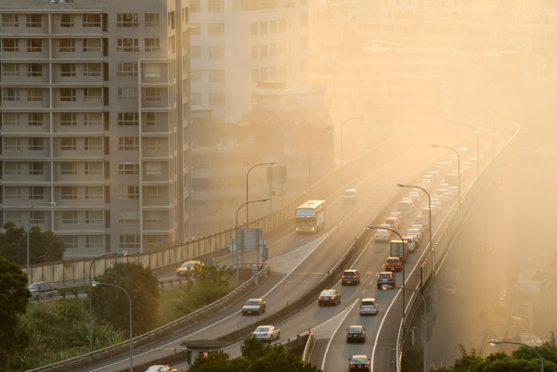
Analysis and Conclusions
Water flume data did indeed support hypothesis
Real-world data only supported experiment to an extent
Limitations - confounding variables, small sample size
Next steps - increased sampling, consideration of other variables, etc.
Notes:
Remember to focus on positive (future) rather than negative (limitations)

Slide 16
Sources
Flori, M., & Milostean, D. (2020). Mathematical Analysis of Air Pollution from Stacks using Briggs Method. Annals of the Faculty of Engineering Hunedoara, 18(4), 145-148.
B. Padmanabhamurty (1975). The Role of Wind in Pollution Dispersion, Journal of the Air Pollution Control Association, 25(9), 956-957, DOI: 10.1080/00022470.1975.10468120
Aristodemou, E., Boganegra, L. M., Mottet, L., Pavlidis, D., Constantinou, A., Pain, C., Robins, A., & ApSimon, H. (2017). How tall buildings affect turbulent air flows and dispersion of pollution within a neighbourhood. Environmental Pollution, 233, 782-796. https://www.sciencedirect.com/science/article/pii/S0269749117319322.
MIT. (n.d.). Urban Street Canyons. http://web.mit.edu/nature/archive/student_projects/2009/jcalamia/Frame/05_canyonwind.html
Kim, K. H., Lee, S. B., Woo, D., & Bae, G. N. (2015). Influence of wind direction and speed on the transport of particle-bound PAHs in a roadway environment. Atmospheric Pollution Research, 6(6), 1024–1034. https://doi.org/10.1016/j.apr.2015.05.007
Miao, Y., Liu, S., Zheng, Y., Wang, S., & Li, Y. (2014). Numerical Study of Traffic Pollutant Dispersion within Different Street Canyon Configurations. Advances in Meteorology. Article 458671. http://dx.doi.org/10.1155/2014/458671.
Environmental Protection Agency (2021). Air Data: Air Quality Data Collected at Outdoor Monitors Across the US. EPA. https://www.epa.gov/outdoor-air-quality-data.
Zeng, Z., Ziegler, A. D., Searchinger, T., Yang, L., Chen, A., Ju, K., ... & Wood, E. F. (2019). A reversal in global terrestrial stilling and its implications for wind energy production. Nature Climate Change, 9(12), 979-985.
Notes:
Add more sources/take out unnecessary ones

Slide 17
Sources Cont.
Shrestha, M. L., Kaga, A., Kondo, A., Inoue, Y., Sugisawa, M., & Sapkota, B. (2004). Simulation of winter air pollution dispersion mechanism of Kathmandu valley by water-tank experiment. Journal of visualization, 7(4), 317-329.
Reuten, C., Steyn, D. G., & Allen, S. E. (2007). Water tank studies of atmospheric boundary layer structure and air pollution transport in upslope flow systems. Journal of Geophysical Research: Atmospheres, 112(D11).
Taseiko, O. V., Mikhailuta, S. V., Pitt, A., Lezhenin, A. A., & Zakharov, Y. V. (2008, October 18). Air pollution dispersion within urban street canyons. Atmospheric Environment, 45 (2), 245-252 https://www.sciencedirect.com/science/article/abs/pii/S1352231008008856.
Environmental Protection Agency (2021). Air Data: Air Quality Data Collected at Outdoor Monitors Across the US. EPA. https://www.epa.gov/outdoor-air-quality-data.
Gerdes, F., & Olivari, D. (1999). Analysis of pollutant dispersion in an urban street canyon. Journal of Wind Engineering and Industrial Aerodynamics, 82(1-3), 105-124.
Mei, D., Wen, M., Xu, X., Zhu, Y., & Xing, F. (2018). The influence of wind speed on airflow and fine particle transport within different building layouts of an industrial city. Journal of the Air & Waste Management Association, 68(10), 1038–1050. https://doi.org/10.1080/10962247.2018.1465487
Oleniacz, R., Bogacki, M., Szulecka, A., Rzeszutek, M., & Mazur, M. (2016). Assessing the impact of wind speed and mixing-layer height on air quality in Krakow (Poland) in the years 2014–2015. Journal of Civil Engineering, Environment and Architecture, 63, 315-342.
Harvey, C. (2019, November 19). The World's Winds Are Speeding Up. Scientific American. https://www.scientificamerican.com/article/the-worlds-winds-are-speeding-up/.
Notes:
Add more sources/take out unnecessary ones

Slide 18
Acknowledgments
Special thanks to Dr. Catherine Hancock and the FSU Fluid Dynamics Institute, Ashley Gannon, Jhamieka Greenwood, Daryn Sagel, and YSP and its Directors!
Notes:
Add more sources/take out unnecessary ones

Slide 19
Thank you for listening! Any Questions?

